Slide 1

Smart Shopping
at
Ali Express
Research question:
Is it possible to predict the quality of a product before purchasing it?
By:
Aviv Levi
Nir Hemed

Slide 2


Introduction
Online orders in the modern era are an integral part of us.
How do we know if a product is good, high quality and justifies the price?
In the project we analysed information about products with the aim of finding the best quality among them.
The goal - determining whether a product is of high quality according to the combination of the investigated parameters.

Slide 3

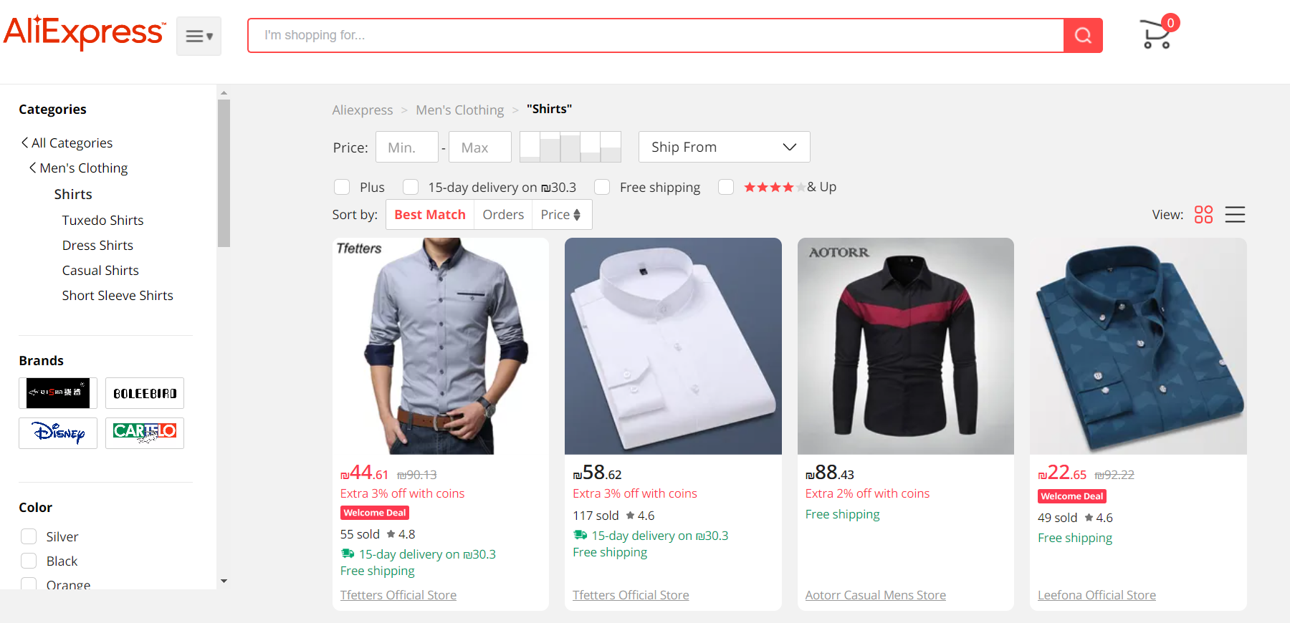


Data sources & crawling
Extracting the products according to their titles and the features we defined

Slide 4


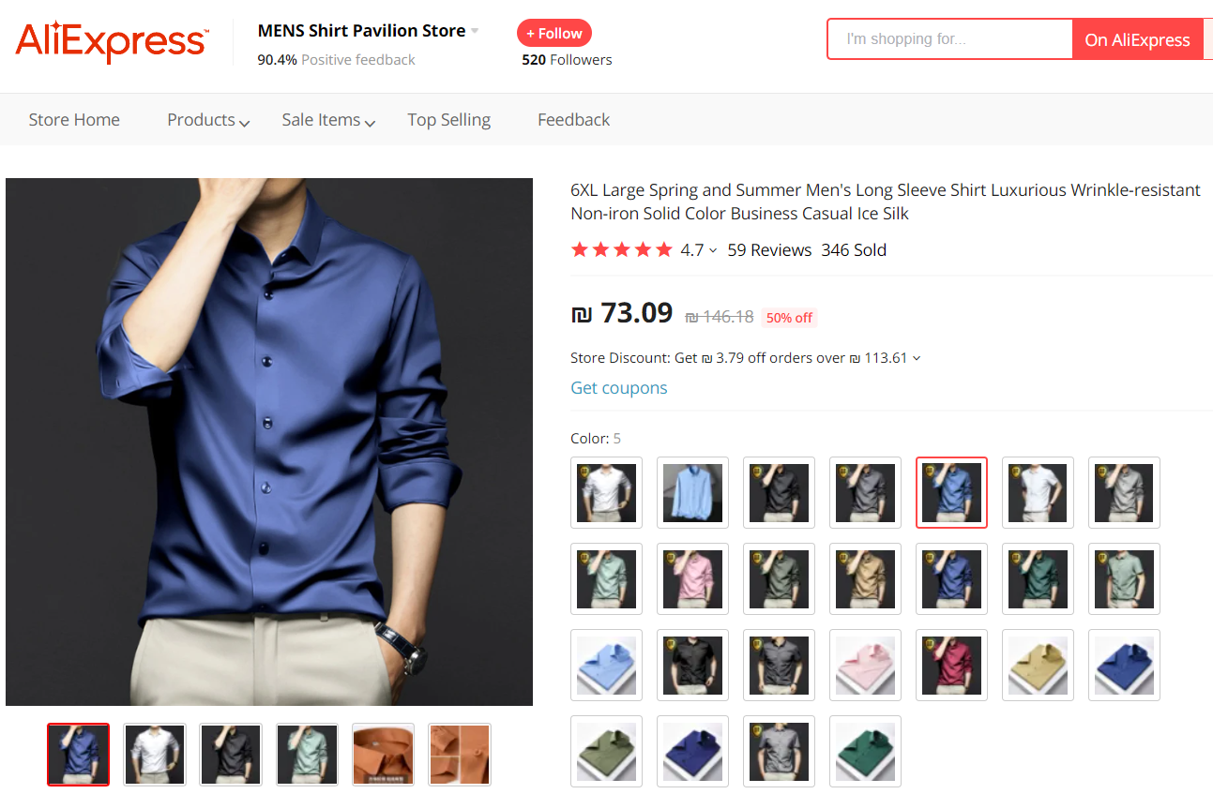
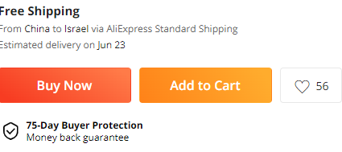
Tools to crawling the Data
Using Selenium
Using the library – BeautifulSoap
Extract all parameters for each product on the page

Slide 5

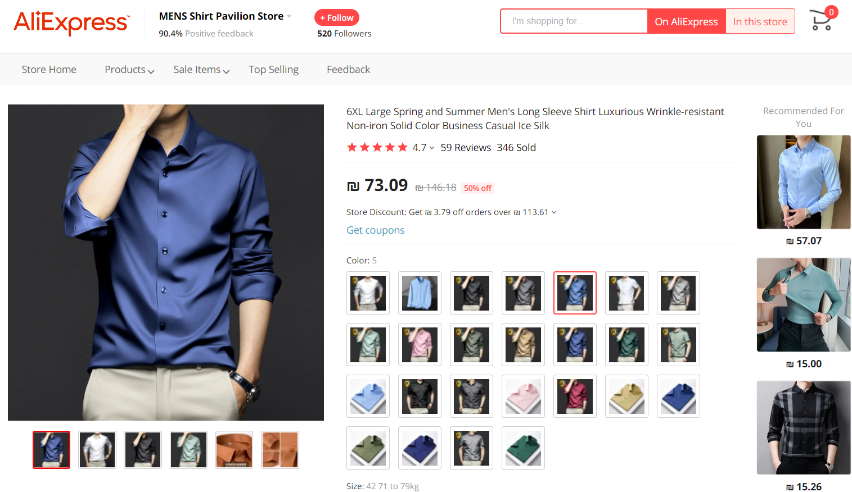
Example of item

Slide 6

Features
Stars
Orders Count
Shipping
Titles
Discounts
Likes
Seller Followers
Seller Rating
Prices

Slide 7

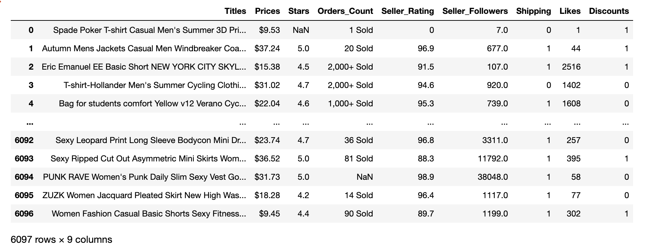
Crawling
Pulling the information from two categories into a ONE DataFrame (before cleaning)

Slide 8


First cleaning of the data
Removing products that do not contain a value in the Titles column
Correcting the price value to a number only without currency and converting it to a float type variable
Replacing all the NaN values with 0 in the Orders Count column and converting the value to an int
Replacing all the NaN values with 0 in the Likes, Seller Followers, Shipping, Discount columns and converting their value to an int type variable
Convert all the values in the Stars and Seller Rating columns to float variables

Slide 9
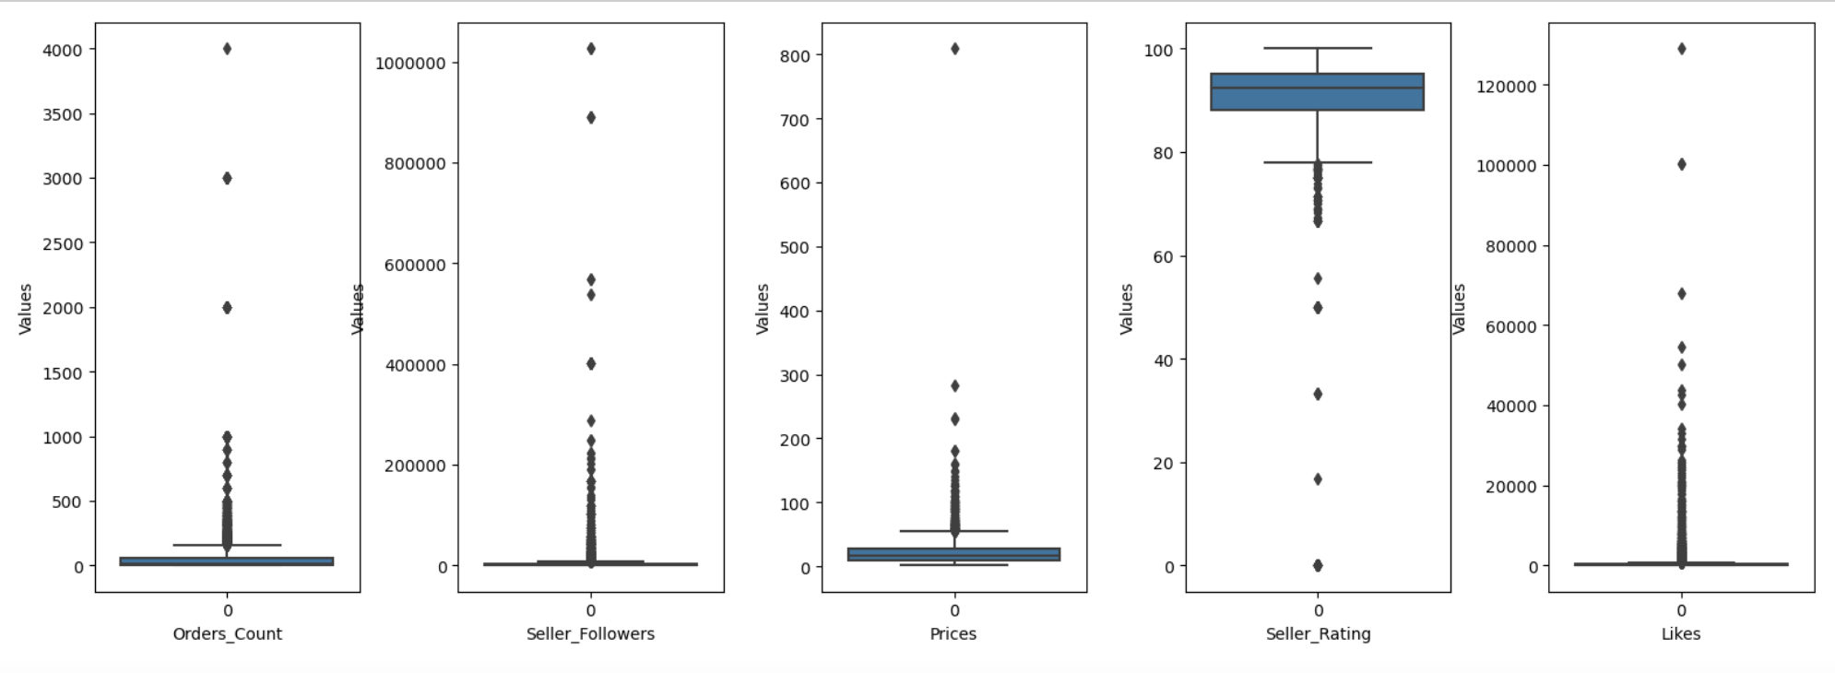
Detecting Outliners:
In the graphs above we can see the outliers in each of our columns.
we will not delete the outlines because they contribute to the understanding of the machine learning

Slide 10
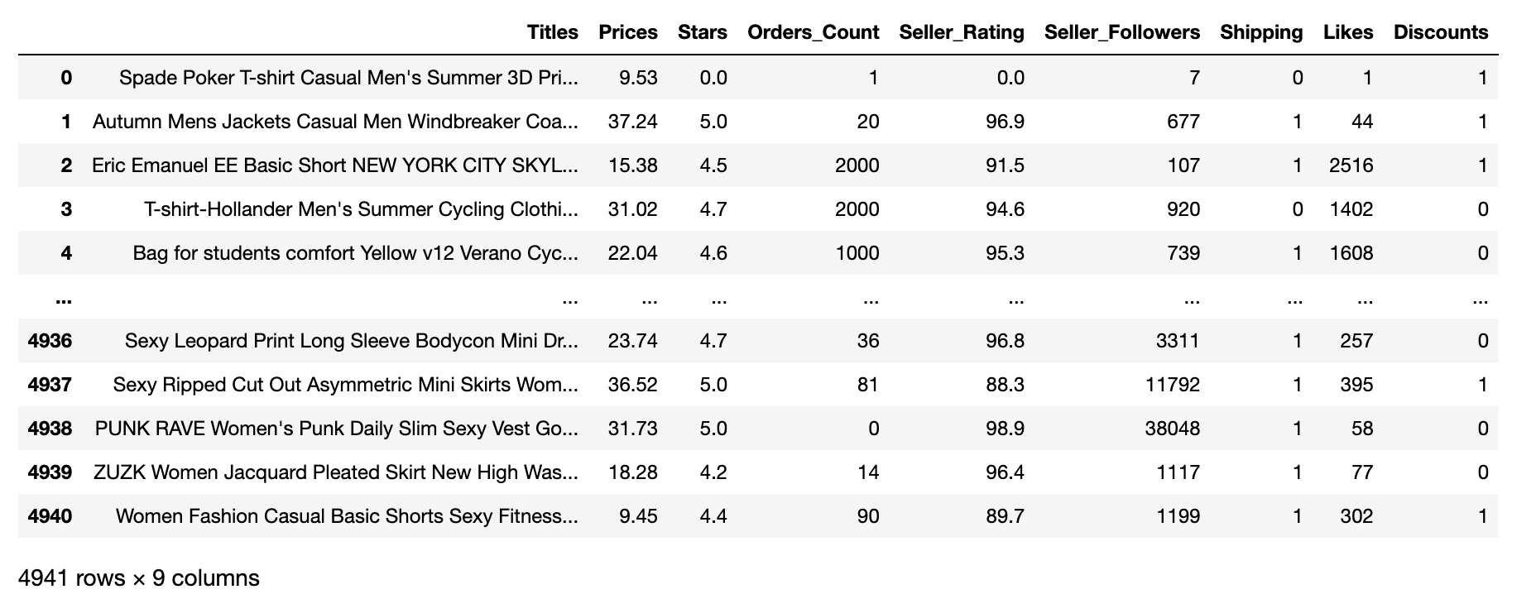
Clean Data

Slide 11

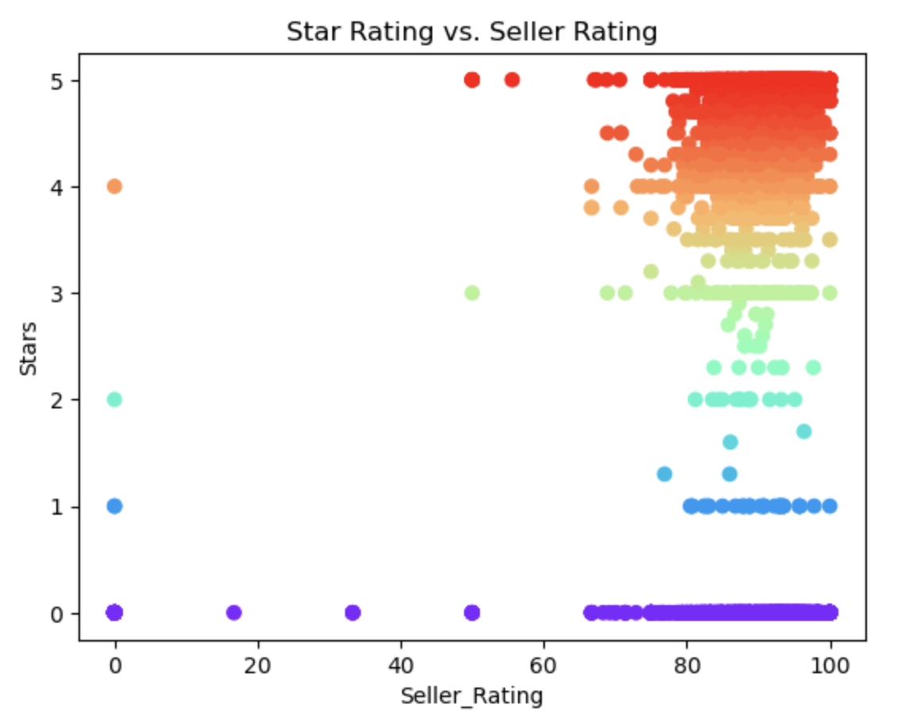

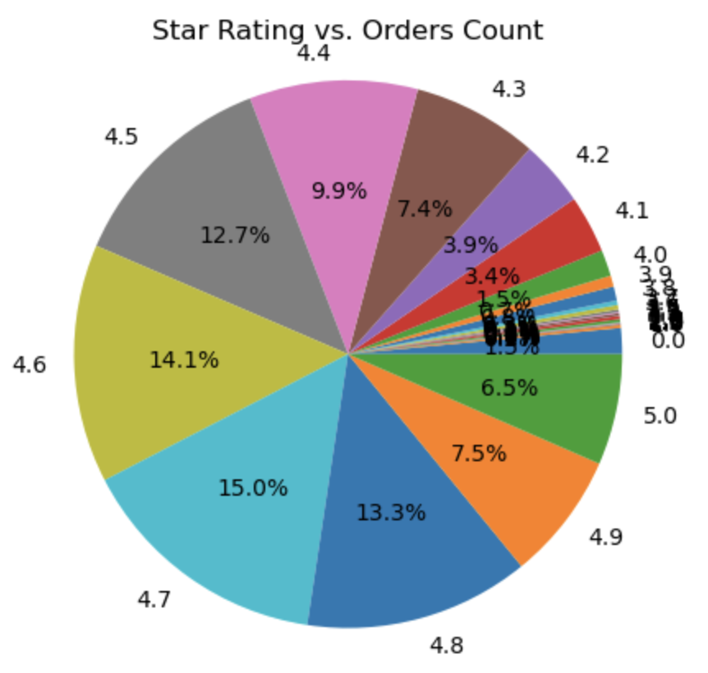
EDA & Visualization

Slide 12
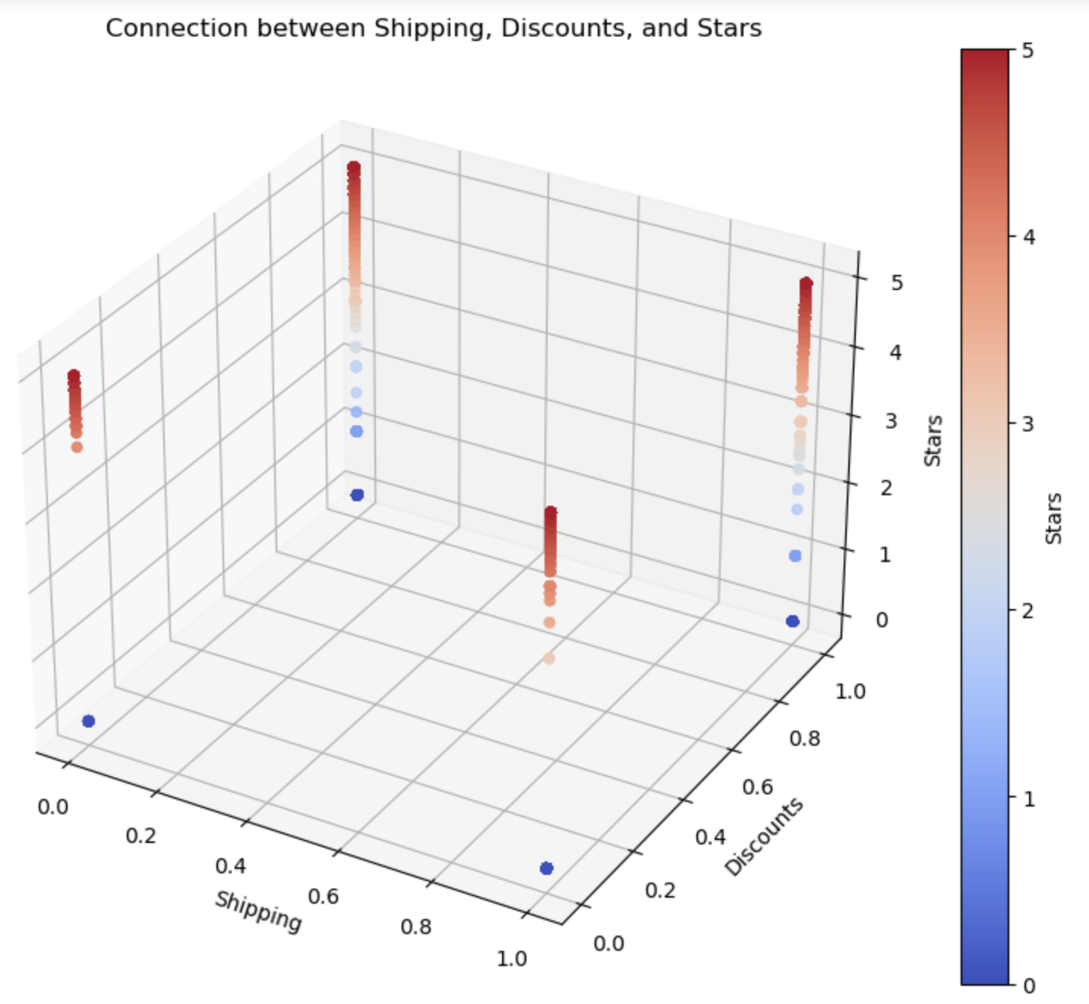
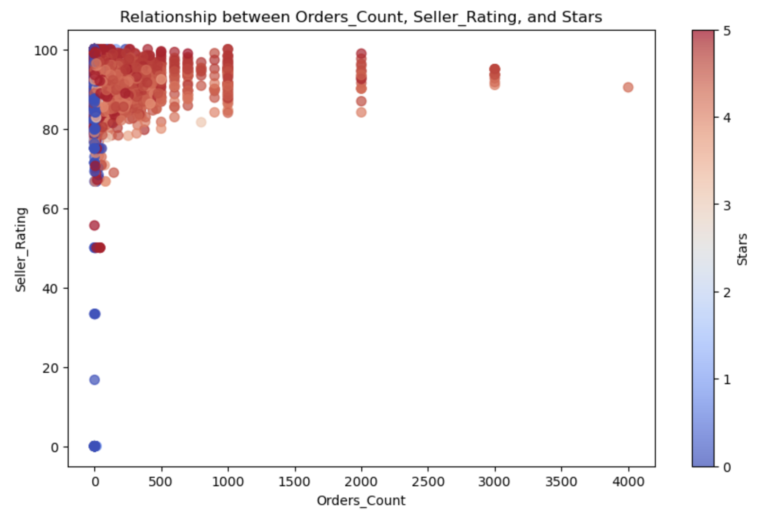
EDA & Visualization

Slide 13
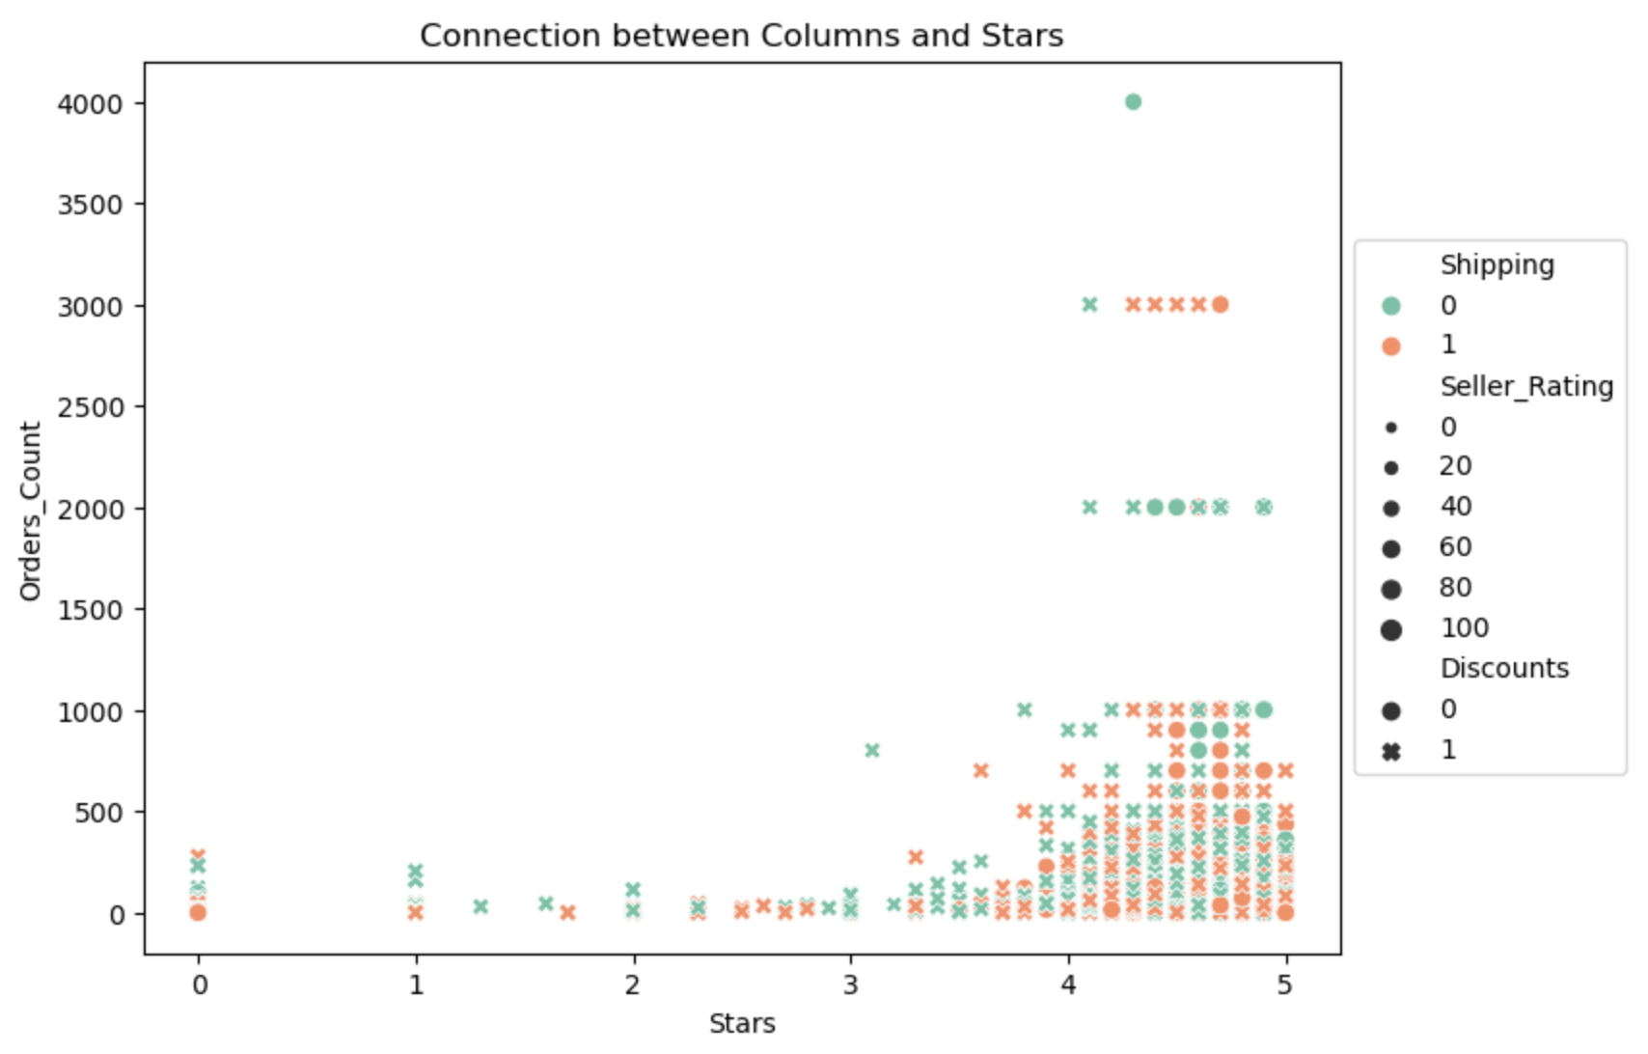
EDA & Visualization

Slide 14

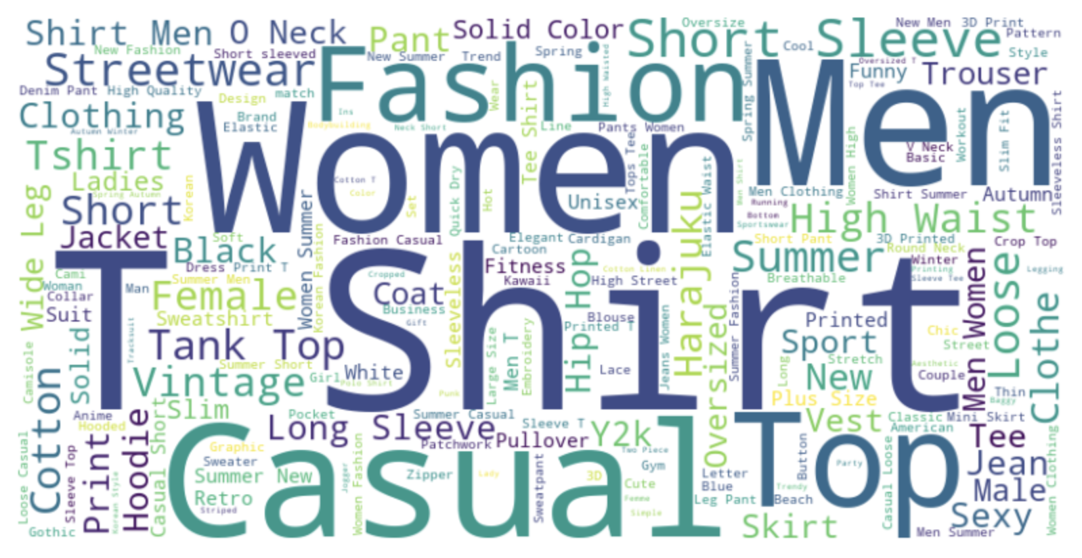
EDA & Visualization
Word Cloud - ‘Titles’ Column

Slide 15

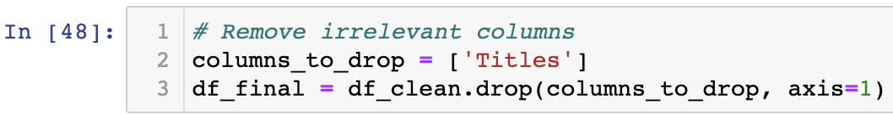
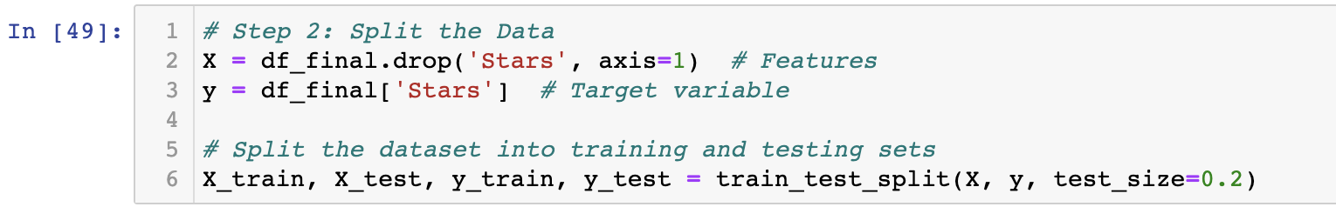
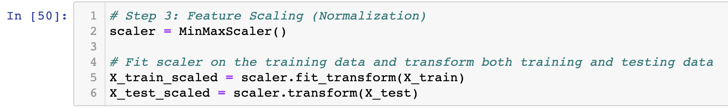
Machine Learning
Remove any irrelevant columns that may not contribute to the prediction
Split the dataset into training and testing sets - 80% for training and 20% for testing.
Feature Scaling - Perform feature scaling on numerical columns "Prices," "Orders_Count," "Seller_rating," and "Likes" to ensure they are on a similar scale. We use normalization.

Slide 16
Machine Learning
Algorithms & Results:
Decision Tree - Regression
Mean Squared Error (MSE) on training data: 2.459
R-squared (R2) on training data: 0.45
Mean Squared Error (MSE) on test data: 2.576
R-squared (R2) on test data: 0.4
KNN
KNN Mean Squared Error (MSE): 3.859
R-squared (R2): 0.11
Leanear Regression
Mean Squared Error (MSE) on training data: 4.157
R-squared (R2) on training data: 0.071
Mean Squared Error (MSE) on test data: 4.051
R-squared (R2) on test data: 0.066
Random Forest
Mean Squared Error (MSE): 2.43
R-squared (R2): 0.439

Slide 17
Machine Learning
Interim summary:
We can see that Random Forest and Decision tree is the two regression models that predicted in the most accurate way. Even though the results still not satisfy , for improve our data and model accuracy we will do the following steps :
Add another new column named 'Good' which will contain values 1 or 0, 1 for good items and 0 for not good, the decision will be determined according to star rating, seller rating and amount of likes.
Up sampling for the Good or Not Good items and convert the stars to int for classification
Perform machine learning again

Slide 18
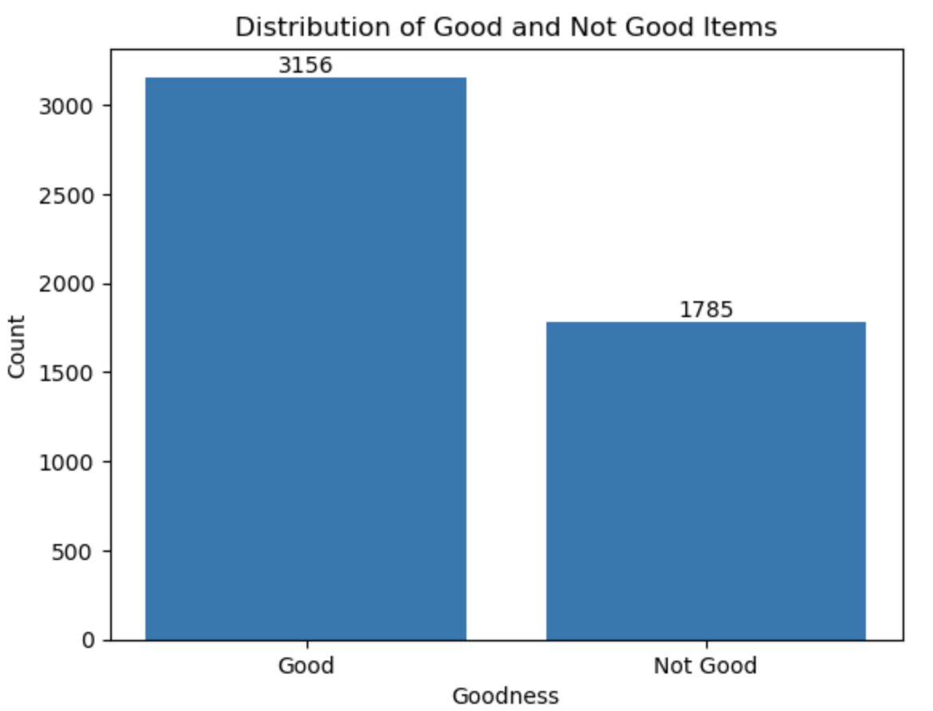
Improve the Machine Learning
Identify the proportions between Good and Bad items:

Slide 19
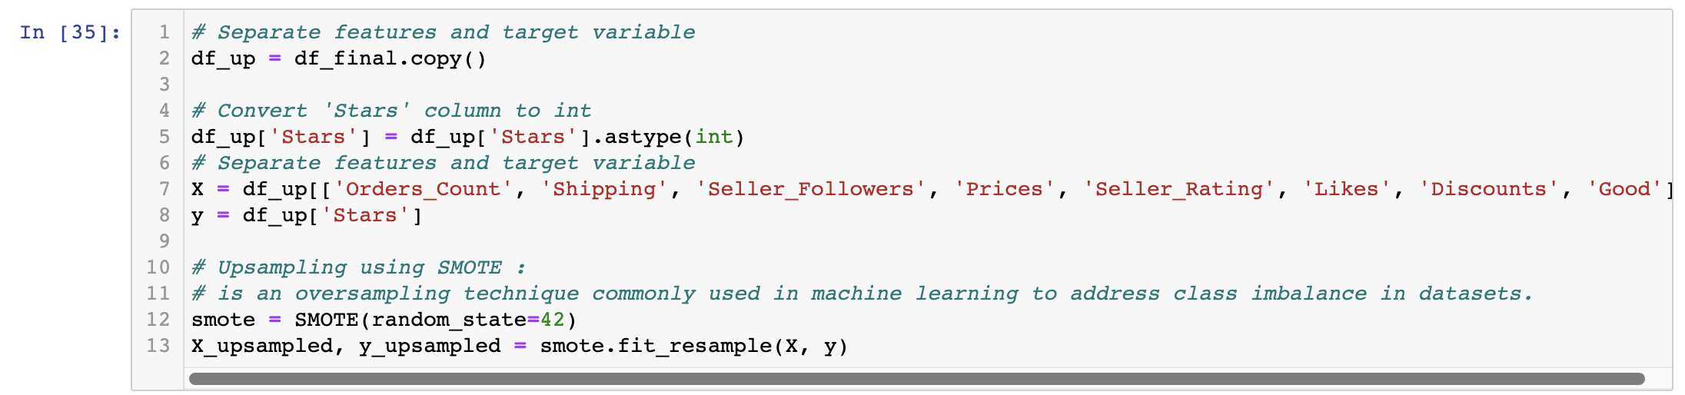
Improve the Machine Learning
UpSampling:
Balancing the data by UpSampling of the minority (Bad items)

Slide 20
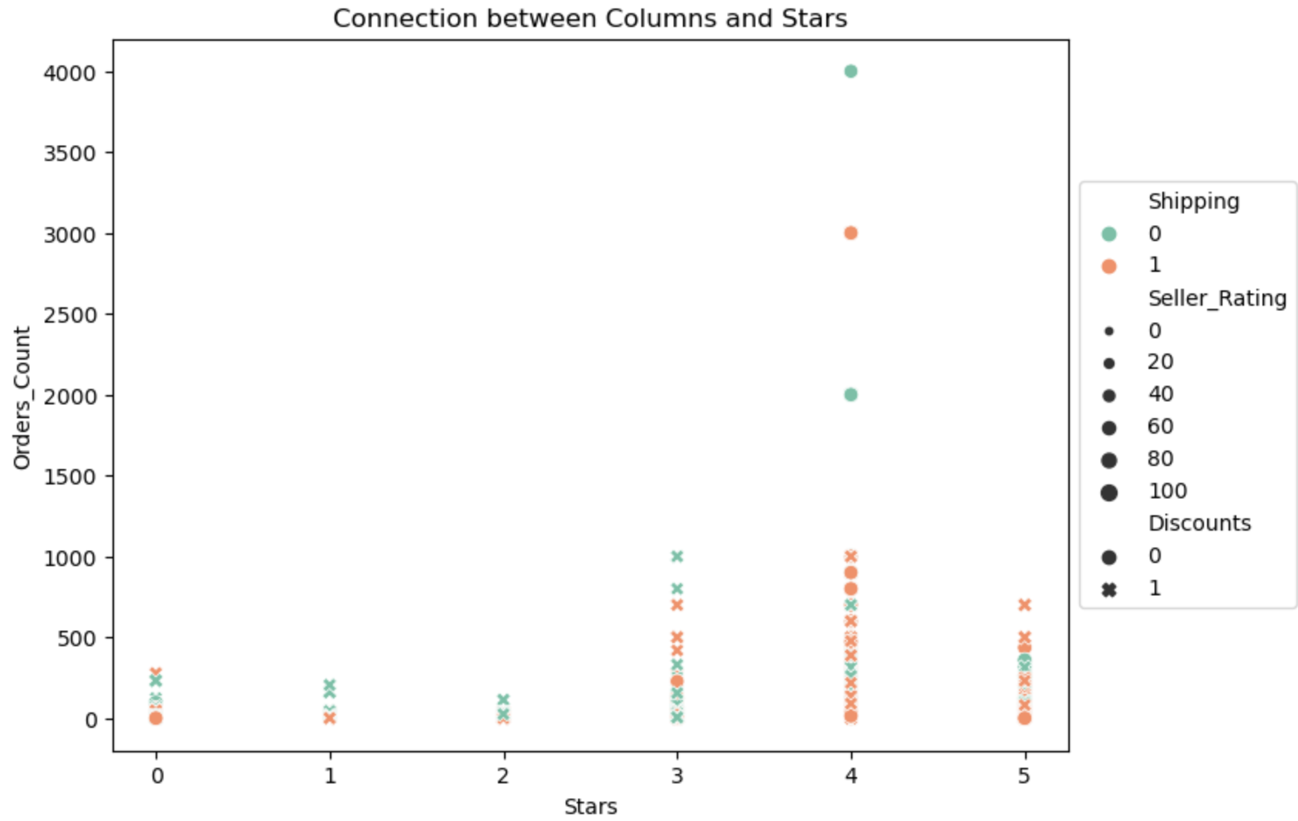
Improve the Machine Learning
Final Results:
Random Forest
Mean Squared Error (MSE): 0.638
R-squared (R2): 0.786

Slide 21

Summary
Most of the products have 3-5 stars.
The high star rating was directly affected by the total number of features (columns) for most of the items.
After further treatment of the data and performing Up Sampling we were able to increase the accuracy of our model (Random Forest) from 0.4 to 0.78.
Predicting the stars rating for a product is approximately 70% accurate.
The model that most accurately predicted the star rating is Random Forest and Decision Tree Regression with an accuracy of 70%.
Good products (rated 3.5-5) can be identified by the relatively high number of orders, the seller's rating, and the number of likes compared to products with a lower rating.

Slide 22

THE END

